Slide 1
3u3 CubeSat Instrument Response
By: Daniel Abel
08/03/2023

Slide 2
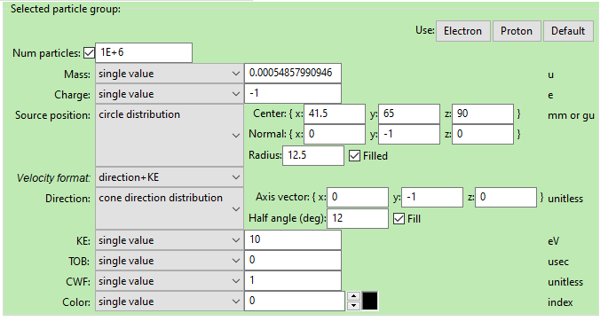
Starting Population Definition for 0deg centerline

Slide 3
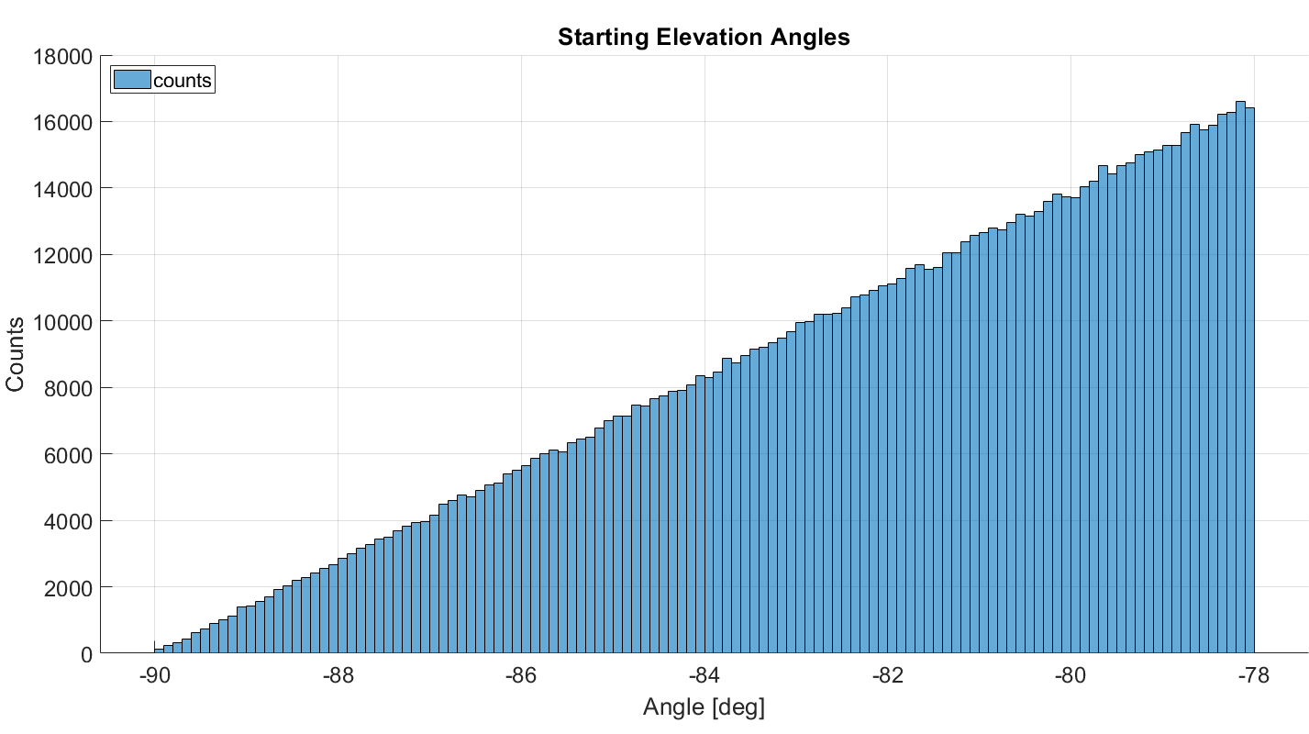
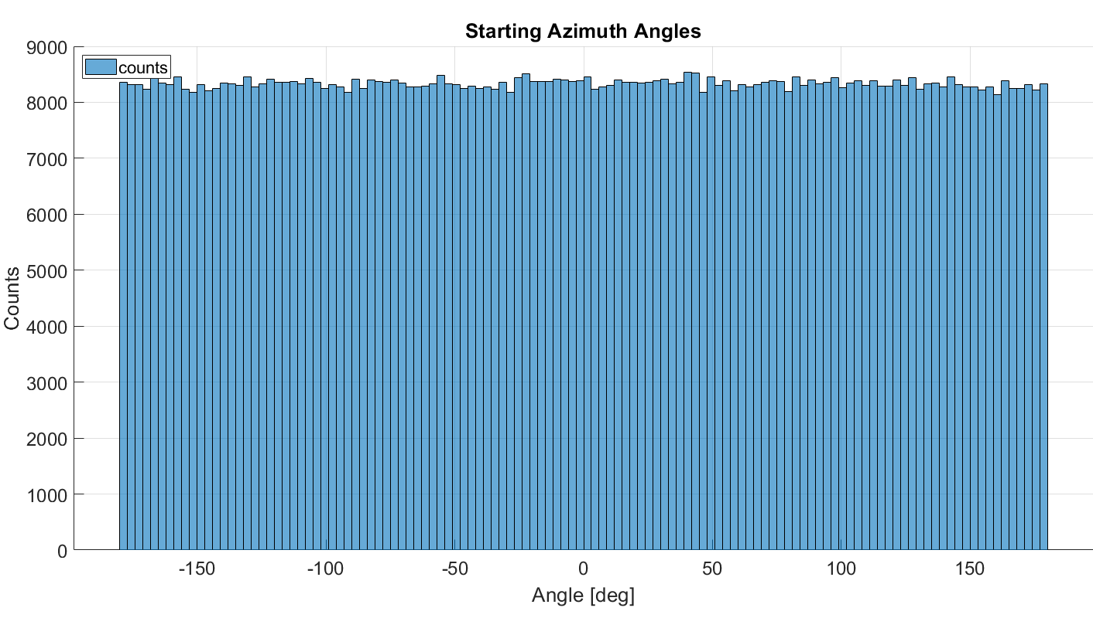
Starting Population Definition Cont. for 0deg from instrument centerline
These graphs are for the 10eV population*
The other particle populations are not identical but have the same definition in SIMION besides energy

Slide 4
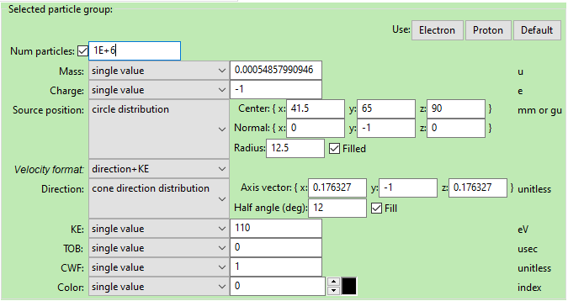
Starting Population Definition for 14° centerline

Slide 5
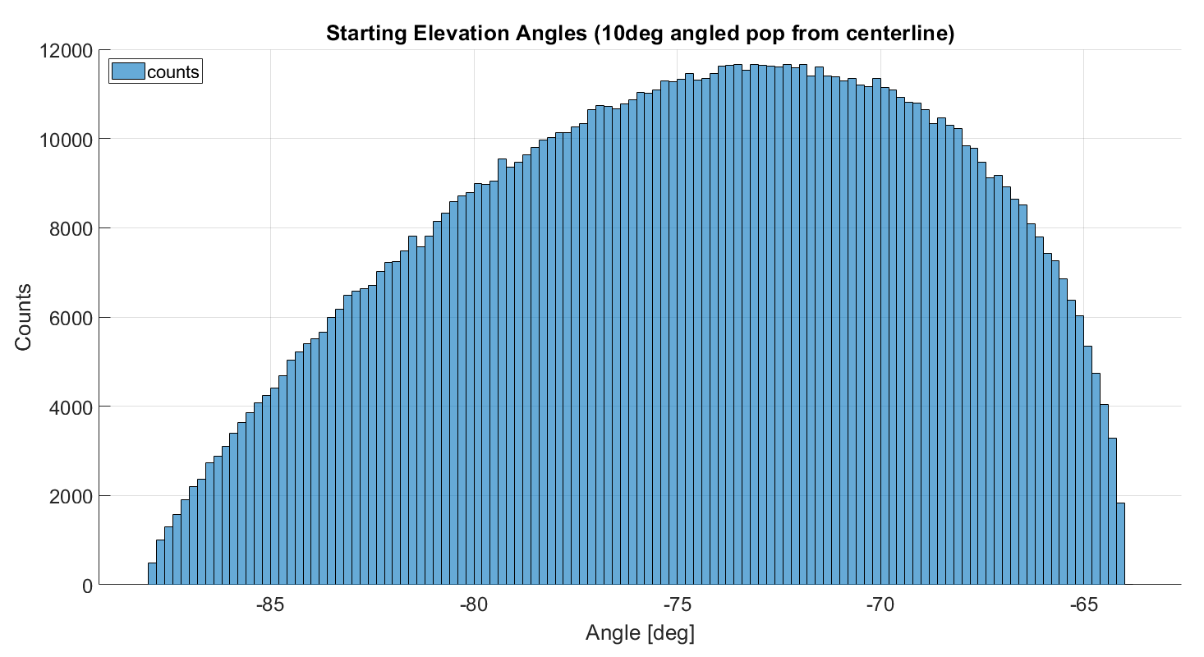
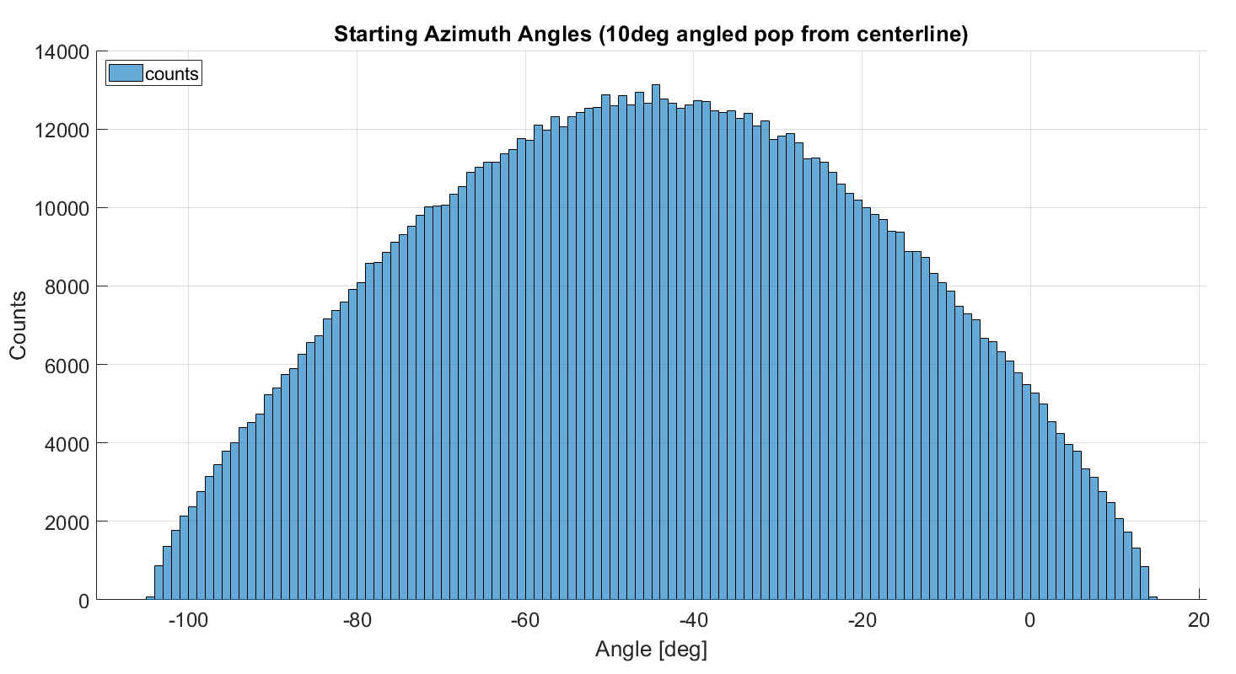
Starting Population Definition Cont. for 14° from instrument centerline

Slide 6
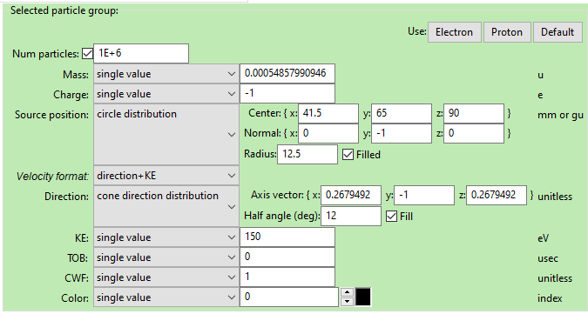
Starting Population Definition for 20.75° centerline

Slide 7
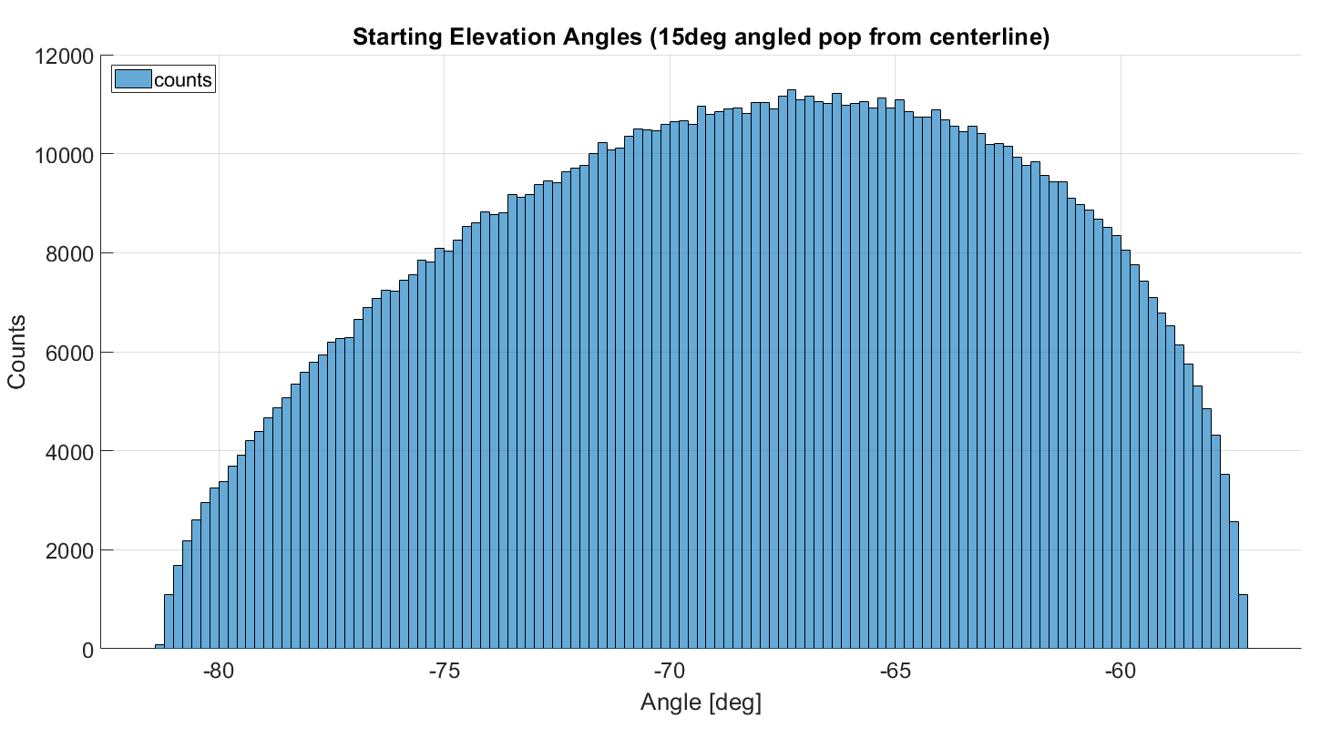
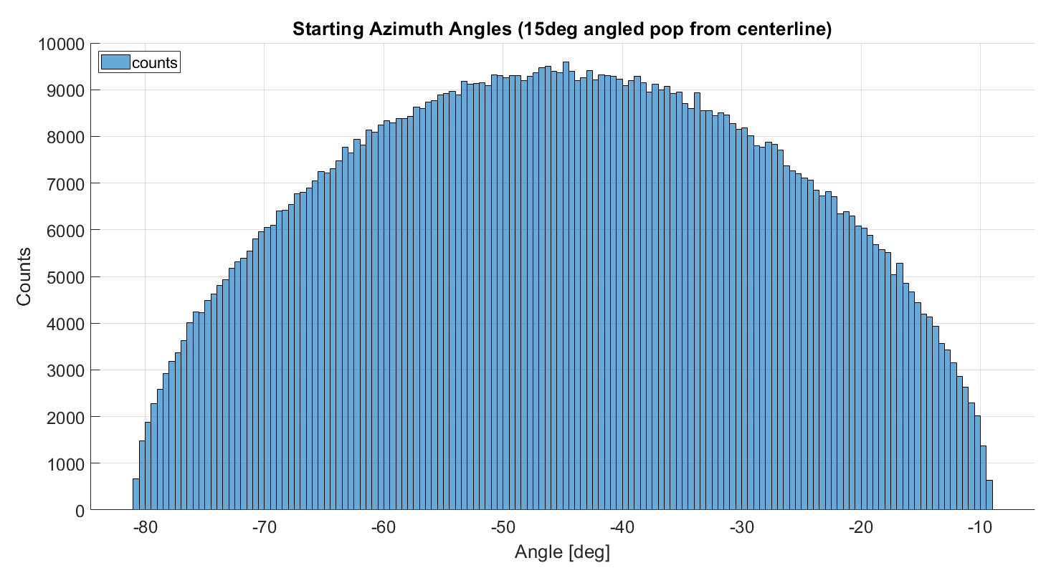
Starting Population Definition Cont. for 20.75° from instrument centerline

Slide 8
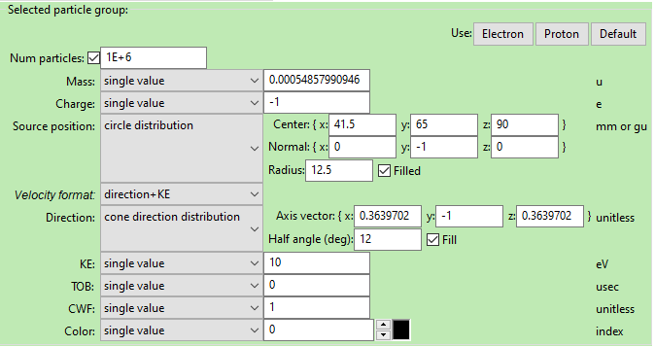
Starting Population Definition for 27.2° centerline

Slide 9
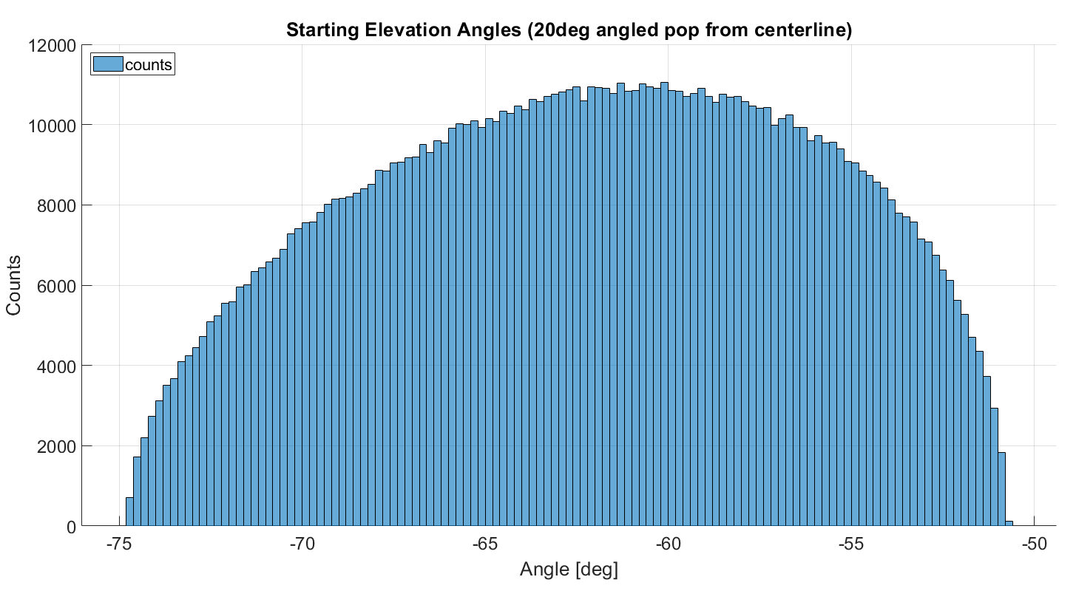
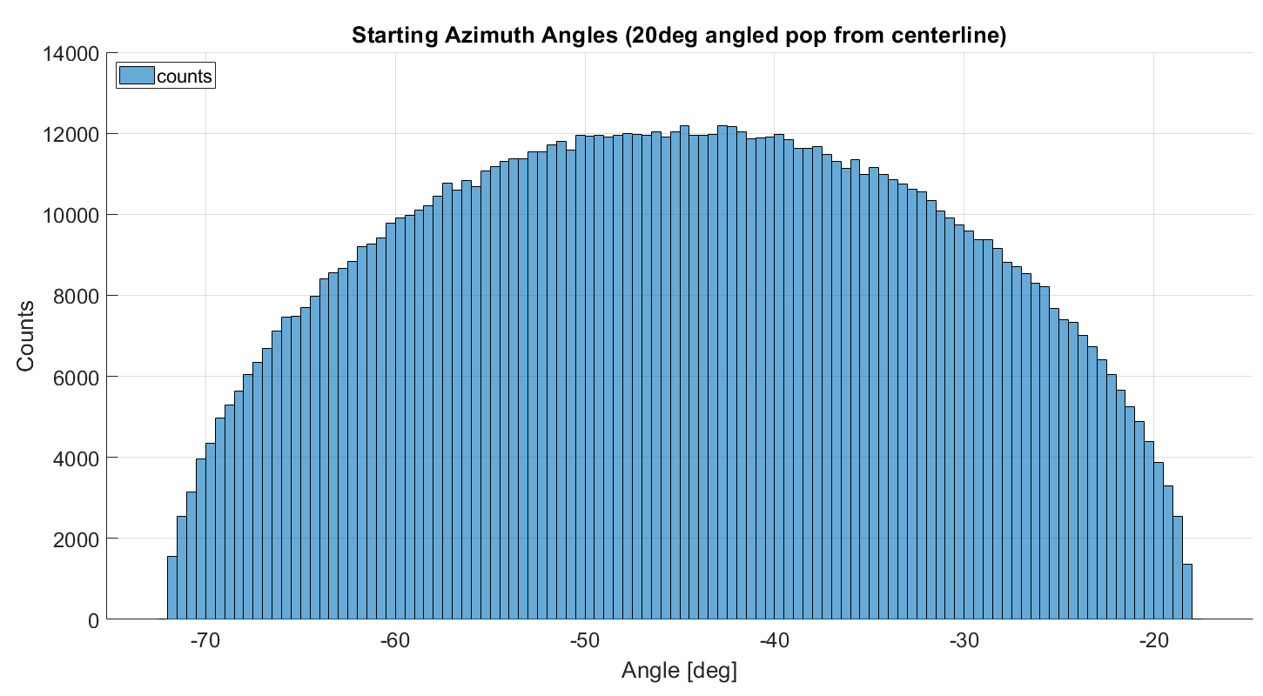
Starting Population Definition Cont. for 20deg from instrument centerline

Slide 10
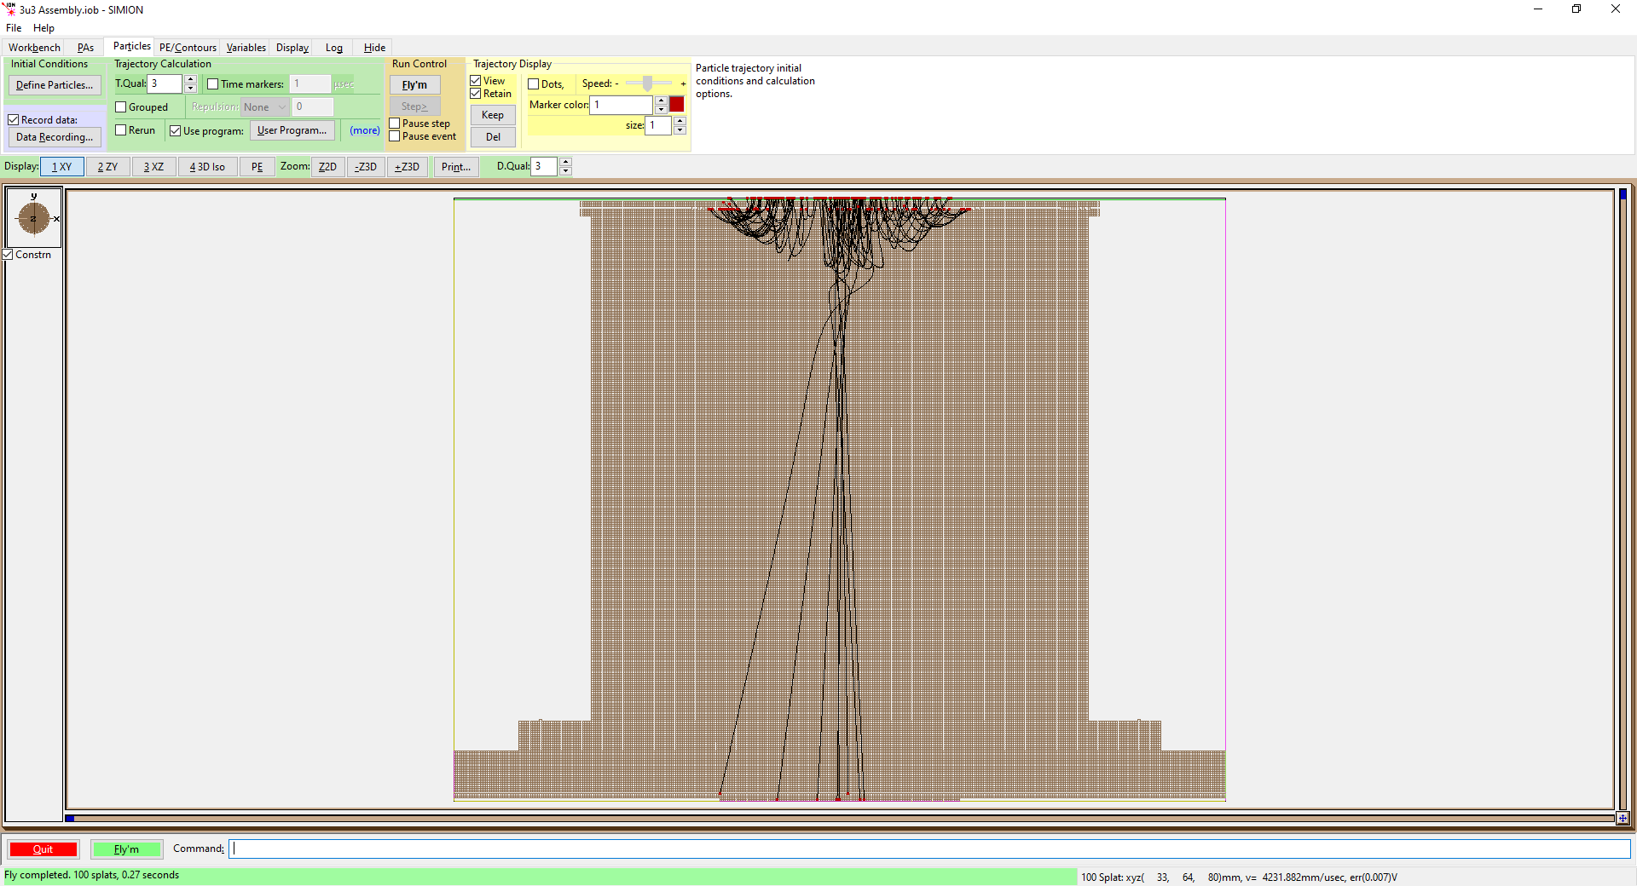
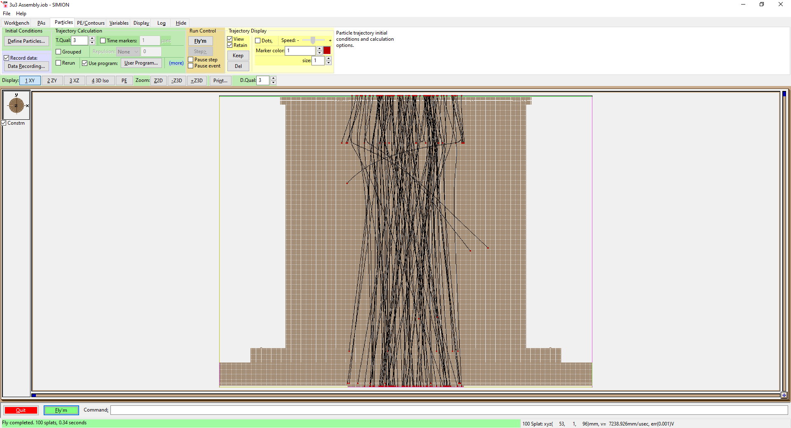
Starting Population Path Examples for 0° from centerline
10eV pop w/ SS = -100V
100 counts*
110eV pop w/ SS = -100V

Slide 11
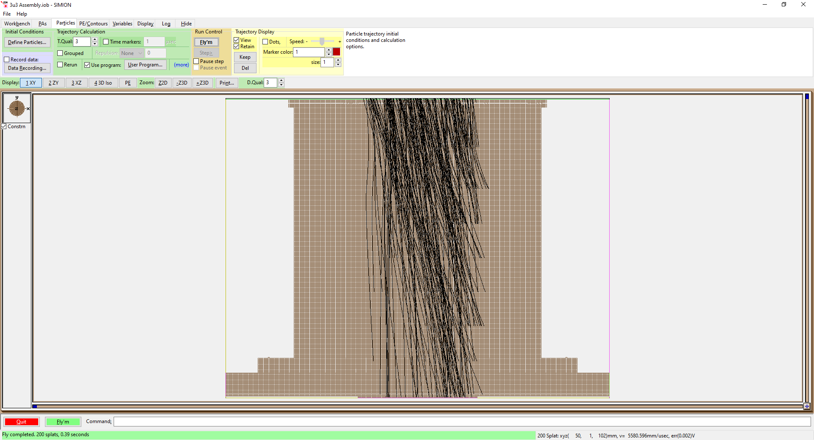
Starting Population Path Examples for 14° from instrument centerline
110eV pop w/ SS = -100V

Slide 12
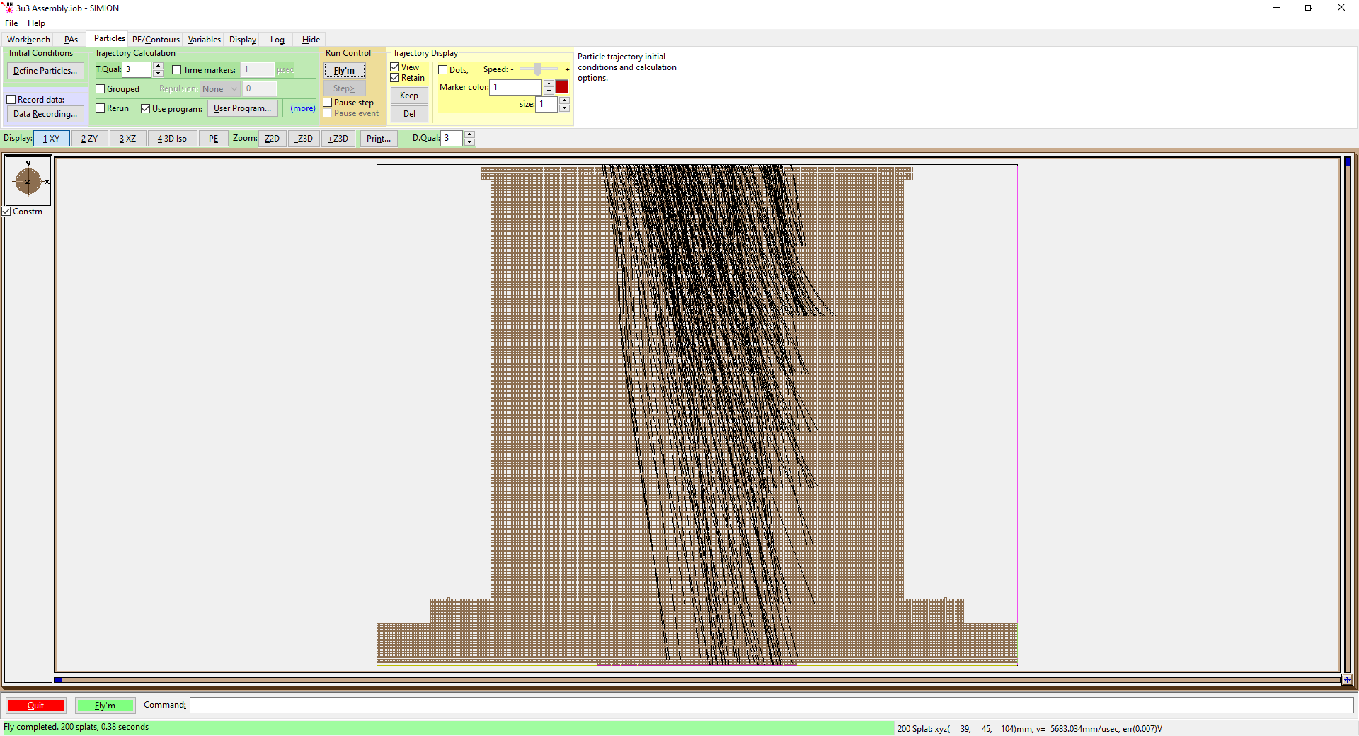
Starting Population Path Examples for 20.75° from instrument centerline
15deg
110eV pop w/ SS = -100V

Slide 13
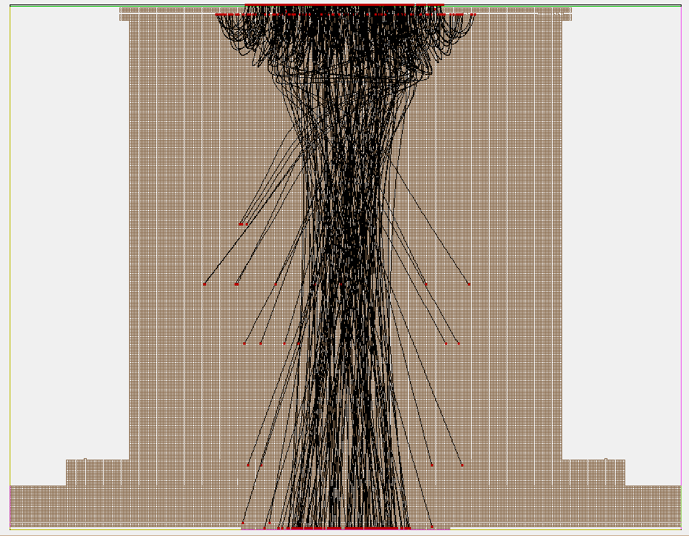
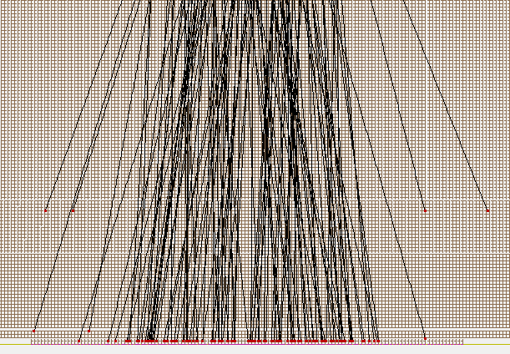
How are the counts determined good or bad?
Green Circle: Counted as impact on anode
Red Circle: Not counted as impact on anode
+y
y=0.2
In the data, if the ending position has a y=0.2,
then it has to have impacted the anode

Slide 14
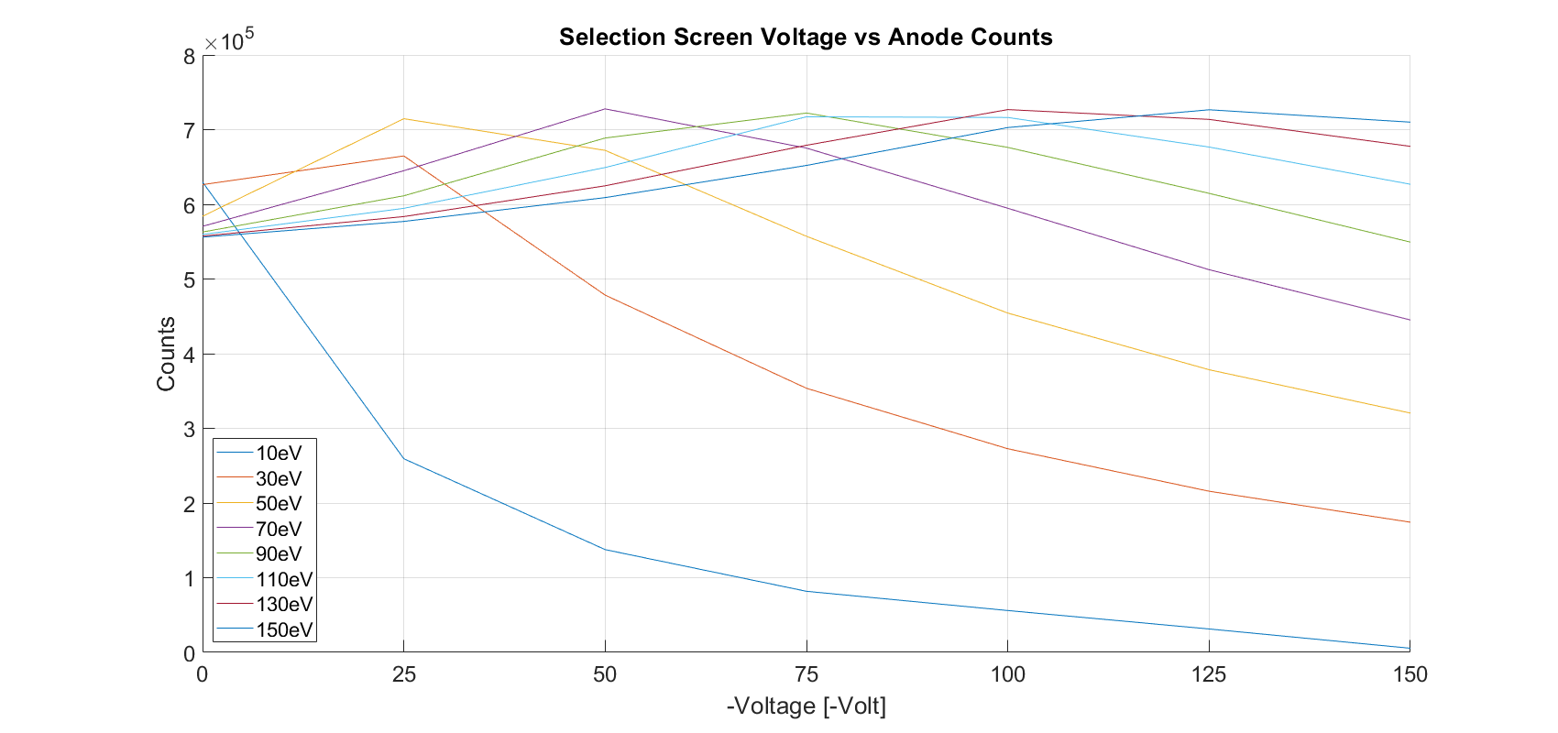
Results for 0° from instrument centerline
150eV
130eV
110eV
90eV
70eV
50eV
30eV
10eV

Slide 15
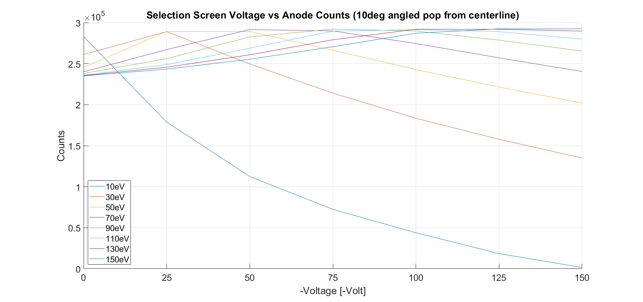
Results for 14° from instrument centerline
150eV
130eV
110eV
90eV
70eV
50eV
30eV
10eV

Slide 16
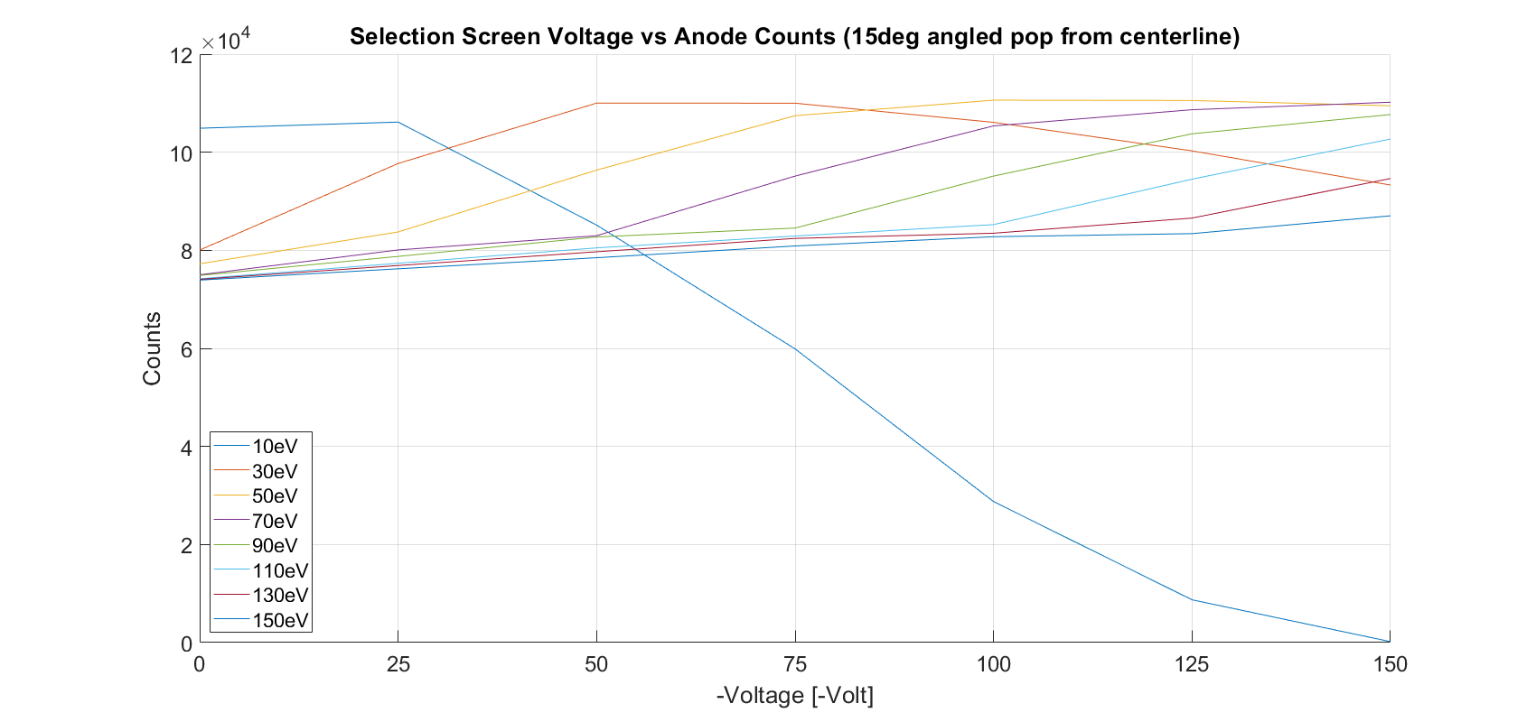
Results for 20.75° from instrument centerline
70eV
50eV
90eV
110eV
130eV
30eV
150eV
10eV

Slide 17
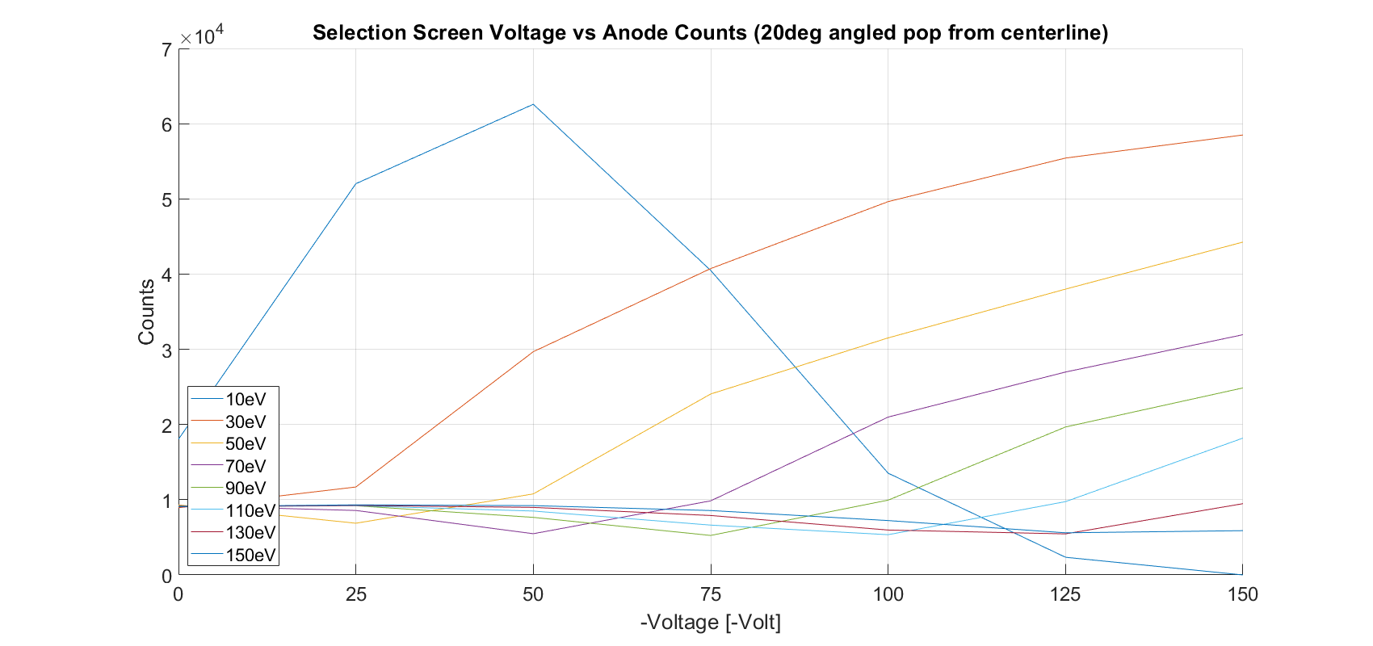
Results for 27.2° from instrument centerline
30eV
50eV
70eV
90eV
110eV
130eV
150eV
10eV

Slide 18
Results Cont. for 0° from instrument centerline
 | 0V | 25V | 50V | 75V | 100V | 125V | 150V
10eV | 62.9764% | 25.9286% | 13.7597% | 8.1785% | 5.6026% | 3.1339% | 0.5507%
30eV | 62.6387% | 66.4793% | 47.8399% | 35.3649% | 27.2674% | 21.5786% | 17.4296%
50eV | 58.4028% | 71.4636% | 67.2241% | 55.7176% | 45.435% | 37.8478% | 32.0438%
70eV | 57.0547% | 64.5030% | 72.7826% | 67.5271% | 59.4709% | 51.2425% | 44.5156%
90eV | 56.2896% | 61.1416% | 68.8815% | 72.2250% | 67.6209% | 61.4701% | 54.9379%
110eV | 55.9649% | 59.4632% | 64.9305% | 71.7235% | 71.6310% | 67.6697% | 62.6855%
130eV | 55.7442% | 58.3589% | 62.4812% | 67.9104% | 72.6859% | 71.3712% | 67.7629%
150eV | 55.6024% | 57.7103% | 60.9006% | 65.2086% | 70.2800% | 72.6626% | 71.0039%
Counts as percentages compared to the 1mil population
Counts are registered only when they impact the anode face

Slide 19
Results Cont. for 14° from instrument centerline
 | 0V | 25V | 50V | 75V | 100V | 125V | 150V
10eV | 28.2991% | 17.884% | 11.2461% | 7.2446% | 4.3886% | 1.8426% | 0.1628%
30eV | 26.1189% | 28.9057% | 24.9641% | 21.4106% | 18.3491% | 15.7822% | 13.5012%
50eV | 24.542% | 28.922% | 28.934% | 26.6413% | 24.2834% | 22.1526% | 20.2007%
70eV | 24.000% | 26.7235% | 29.1566% | 28.9913% | 27.4547% | 25.7091% | 24.043%
90eV | 23.8067% | 25.6067% | 28.2657% | 29.2177% | 28.9833% | 27.8679% | 26.5469%
110eV | 23.5959% | 24.8943% | 26.8846% | 28.9716% | 29.1475% | 28.9039% | 27.9859%
130eV | 23.5556% | 24.5695% | 26.077% | 27.912% | 29.1974% | 29.1922% | 28.9726%
150eV | 23.5094% | 24.3404% | 25.5398% | 27.0666% | 28.7127% | 29.2408% | 29.2452%
Counts as percentages compared to the 1mil population – Correspond to 40 – 45% of 0° peak
Counts are registered only when they impact the anode face

Slide 20
Results Cont. for 20.75° from instrument centerline
 | 0V | 25V | 50V | 75V | 100V | 125V | 150V
10eV | 10.4889% | 10.6148% | 8.5136% | 5.9892% | 2.8749% | 0.8724% | 0.0187%
30eV | 8.0043% | 9.7706% | 11.0023% | 10.9997% | 10.6094% | 10.0273% | 9.3304%
50eV | 7.7243% | 8.3742% | 9.6353% | 10.7451% | 11.061% | 11.0547% | 10.9474%
70eV | 7.5007% | 8.0077% | 8.2975% | 9.5139% | 10.5369% | 10.8668% | 11.0192%
90eV | 7.4873% | 7.8756% | 8.2716% | 8.4535% | 9.5138% | 10.3763% | 10.7684%
110eV | 7.4198% | 7.7351% | 8.0496% | 8.291% | 8.5238% | 9.4507% | 10.2692%
130eV | 7.4085% | 7.6893% | 7.970% | 8.2423% | 8.3482% | 8.6569% | 9.4642%
150eV | 7.3922% | 7.6226% | 7.8484% | 8.0886% | 8.277% | 8.3398% | 8.7034%
Counts as percentages compared to the 1mil population. Shift to higher energies. 14 – 20% of peak at 0° (up to ~30% for highest energy steps)
Counts are registered only when they impact the anode face

Slide 21
Results Cont. for 27.2° from instrument centerline
 | 0V | 25V | 50V | 75V | 100V | 125V | 150V
10eV | 1.8044% | 5.2023% | 6.2578% | 4.0481% | 1.3527% | 0.235% | 0.000%
30eV | 0.8933% | 1.1693% | 2.9683% | 4.0736% | 4.9636% | 5.5428% | 5.8495%
50eV | 0.9309% | 0.6876% | 1.0773% | 2.406% | 3.1517% | 3.8004% | 4.4257%
70eV | 0.9211% | 0.8573% | 0.5481% | 0.9853% | 2.0992% | 2.6981% | 3.1941%
90eV | 0.9143% | 0.9197% | 0.7656% | 0.5251% | 0.9943% | 1.9673% | 2.4865%
110eV | 0.9061% | 0.9201% | 0.8497% | 0.6625% | 0.5352% | 0.9749% | 1.8196%
130eV | 0.9043% | 0.9243% | 0.898% | 0.7903% | 0.597% | 0.5458% | 0.9478%
150eV | 0.9088% | 0.9317% | 0.9215% | 0.8564% | 0.723% | 0.5602% | 0.5888%
Counts as percentages compared to the 1mil population. Shift to highest energies. Only 7-9% of peak
Counts are registered only when they impact the anode face

